Slide 1

Integrated Circuit
Function
BD7F100EFJ
INTERNAL REGULATOR (VREF)
SOFT START
Panagiotis Christodoulou

Slide 2

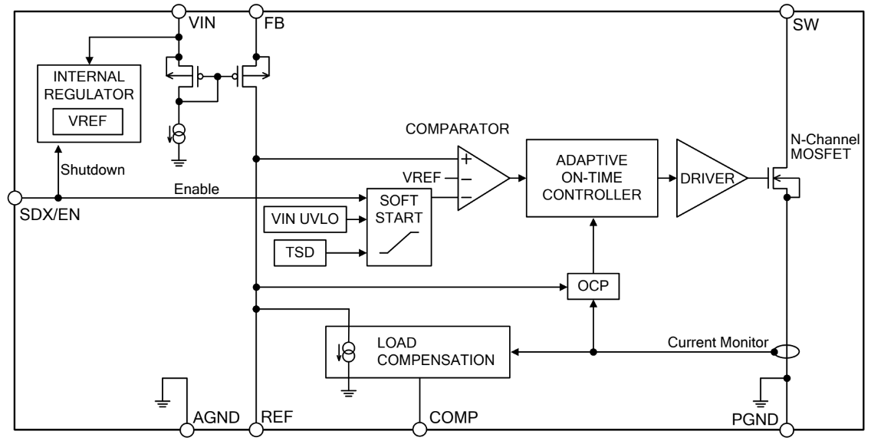
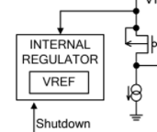
Figure 1. BD7F100EF-EVK-002-U1 Block Diagram
Figure 2. Internal Regulator Block Diagram
INTERNAL REGULATOR (VREF)
This is the regulator block for internal circuits which includes a reference voltage generating block (VREF).
This block is in the shutdown state when the SDX/EN terminal is below 0.9V.
Basic Principles of Power Electronics
Supervisor: Professor Nikolaos Papanikolaou

Slide 3
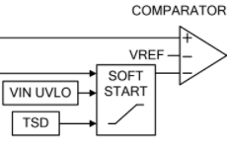
SOFT START
This is the block which the SDX/EN terminal is in the enable state with more than 2.0V, this block prevents inrush current and overshoot in the rising of the output voltage by making the reference voltage of the COMPARATOR block rise slowly from
0V to VREF voltage.
The default soft start time, tSS, is designed to be 6ms (Typ) internally.
The min off time is 750ns when the output voltage is below 50% of the set voltage.
Figure 3. Soft Start of
BD7F100EF-EVK-002-U1 Block Diagram
Basic Principles of Power Electronics
Supervisor: Professor Nikolaos Papanikolaou

Slide 4
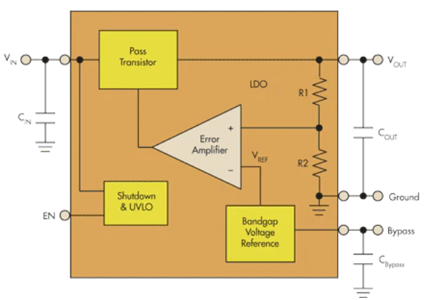
INTERNAL REGULATOR (VREF)
Among regulators, the simplest regulator circuit is for a low-dropout (LDO) voltage regulator whose topology is shown in Figure 4. As a linear voltage regulator, its main components are a pass transistor, error amplifier, voltage reference, and output power MOSFET. One input to the error amplifier, set by resistors R1 and R2, monitors a percentage of the output voltage. The other input is a stable voltage reference (VREF). If the output voltage increases relative to VREF, the error amplifier changes the pass-transistor’s output to maintain a constant output voltage (VOUT).
● Vout=(1+R1/R2)VREF
Figure 4. Internal Regulator
Basic Principles of Power Electronics
Supervisor: Professor Nikolaos Papanikolaou
Notes:
https://www.youtube.com/watch?v=MlDYP34FsMs

Slide 5
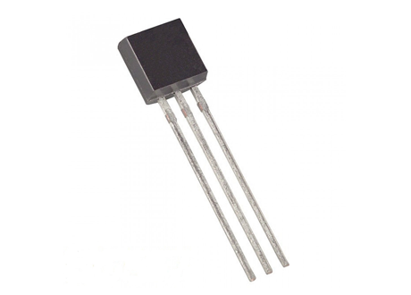
Pass transistor
● Based on the voltage applied at the base terminal of a transistor switching operation is performed. When a sufficient voltage (V_{IN} > 0.7 V) is applied between the base and emitter, collector to emitter voltage is approximately equal to 0. Therefore, the transistor acts as a short circuit. The collector current V_{CC} / R_{C} flows through the transistor.
● When no voltage or zero voltage is applied at the input, transistor operates in cutoff region and acts as an open circuit. In this type of switching connection, load (here an LED is used as a load) is connected to the switching output with a reference point. Thus, when the transistor is switched ON, current will flow from source to ground through the load.
Basic Principles of Power Electronics
Supervisor: Professor Nikolaos Papanikolaou

Slide 6
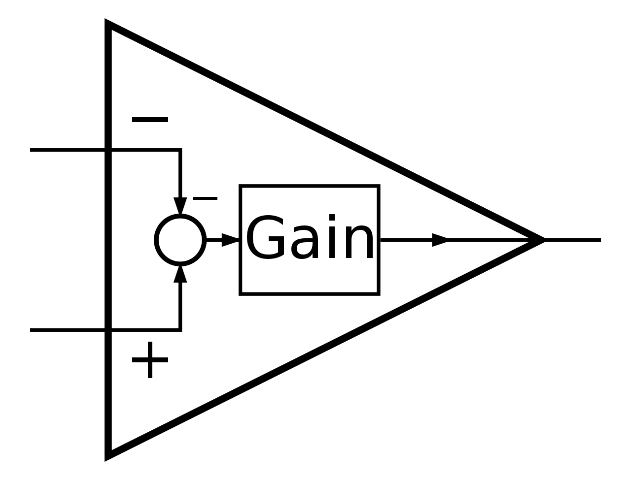
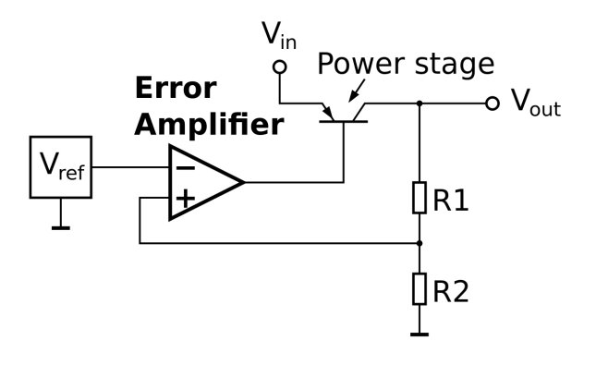
Error Amplifier
An error amplifier is most commonly encountered in feedback unidirectional voltage control circuits, where the sampled output voltage of the circuit under control, is fed back and compared to a stable reference voltage. An error amplifier is essentially what its name says, that is, it amplifies an error signal.
Bandgap Voltage Reference
A bandgap voltage reference is a temperature independent voltage reference circuit widely used in intergrated circuits. It produces a fixed (constant) voltage regardless of power supply variations, temperature changes, or circuit loading from a device.
Basic Principles of Power Electronics
Supervisor: Professor Nikolaos Papanikolaou

Slide 7
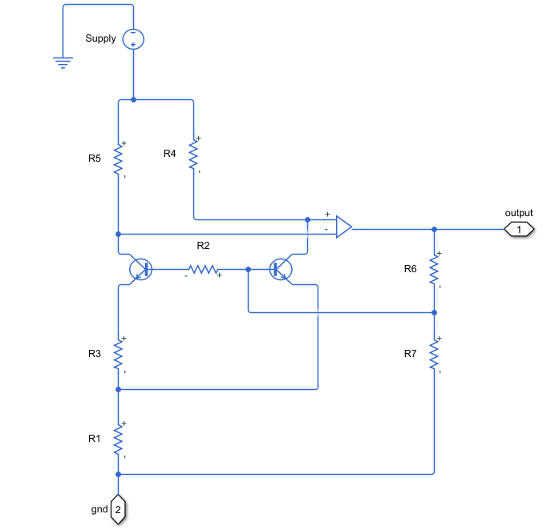
Brakaw Bandgap Voltage Reference with voltage divider
● The Brakaw Voltage Reference has output voltage around 1.25 V with low temperature dependence.
● R6 , R7 control the output voltage.
Basic Principles of Power Electronics
Supervisor: Professor Nikolaos Papanikolaou

Slide 8
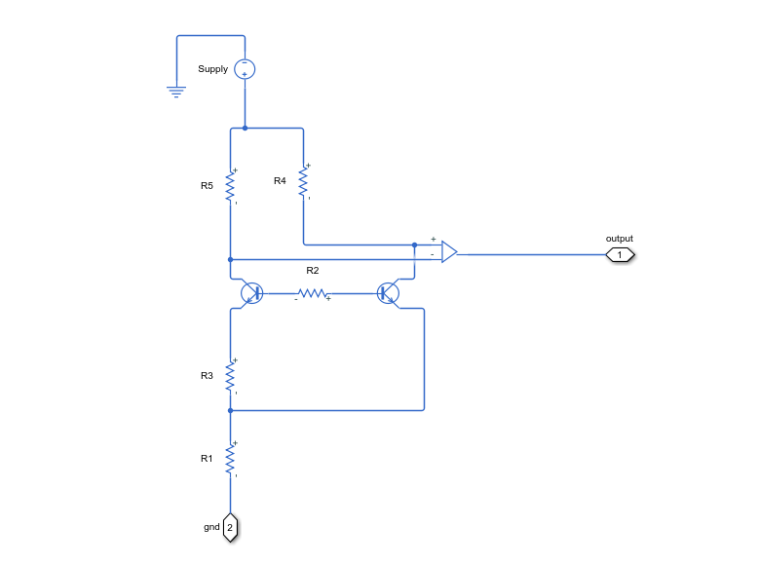
● The circuit maintains an internal voltage source that has a positive temperature coefficient and another internal voltage source that has a negative temperature coefficient.
By summing the two together, the temperature dependence can be canceled.
● The op-amp ensures that its inverting and non-inverting inputs are at the same voltage. The collector currents of Q1 and Q2 are also identical
● If Q2 has an emitter area that is N times larger than Q1, its base-emitter voltage will be lower than that of Q1 by a magnitude of kT/q*ln(N).
Brakaw Bandgap Voltage Reference
Basic Principles of Power Electronics
Supervisor: Professor Nikolaos Papanikolaou

Slide 9
● If Q2 has an emitter area that is N times larger than Q1, its base-emitter voltage will be lower than that of Q1 by a magnitude of kT/q*ln(N).
k → Boltzmann constant
q → charge carried by single electron
T → temperature in Kelvin
● By an appropriate choice of N and R1 and R3, these temperature coefficients can be made to cancel, giving an output voltage that is nearly independent of temperature.
Basic Principles of Power Electronics
Supervisor: Professor Nikolaos Papanikolaou

Slide 10
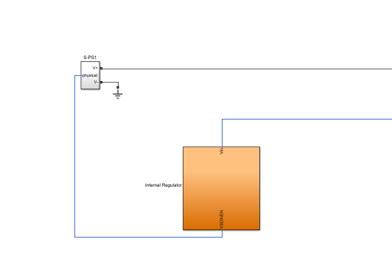
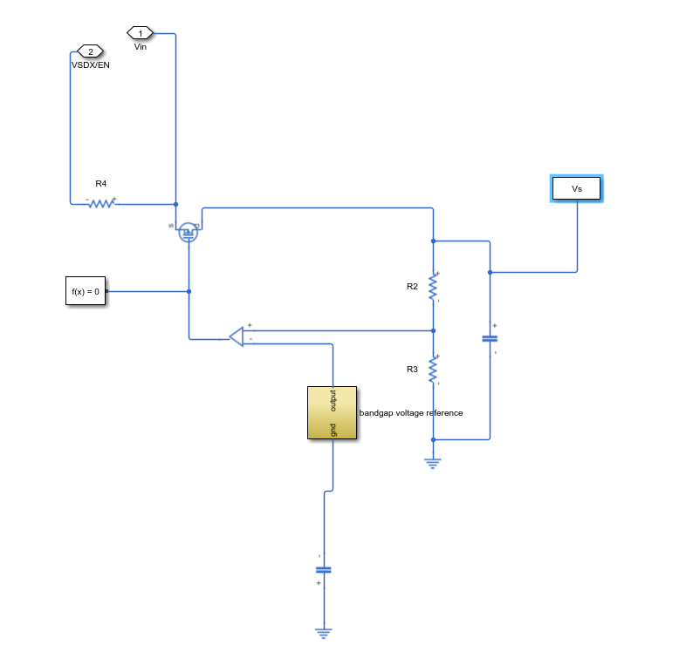
Basic Principles of Power Electronics
Supervisor: Professor Nikolaos Papanikolaou

Slide 11
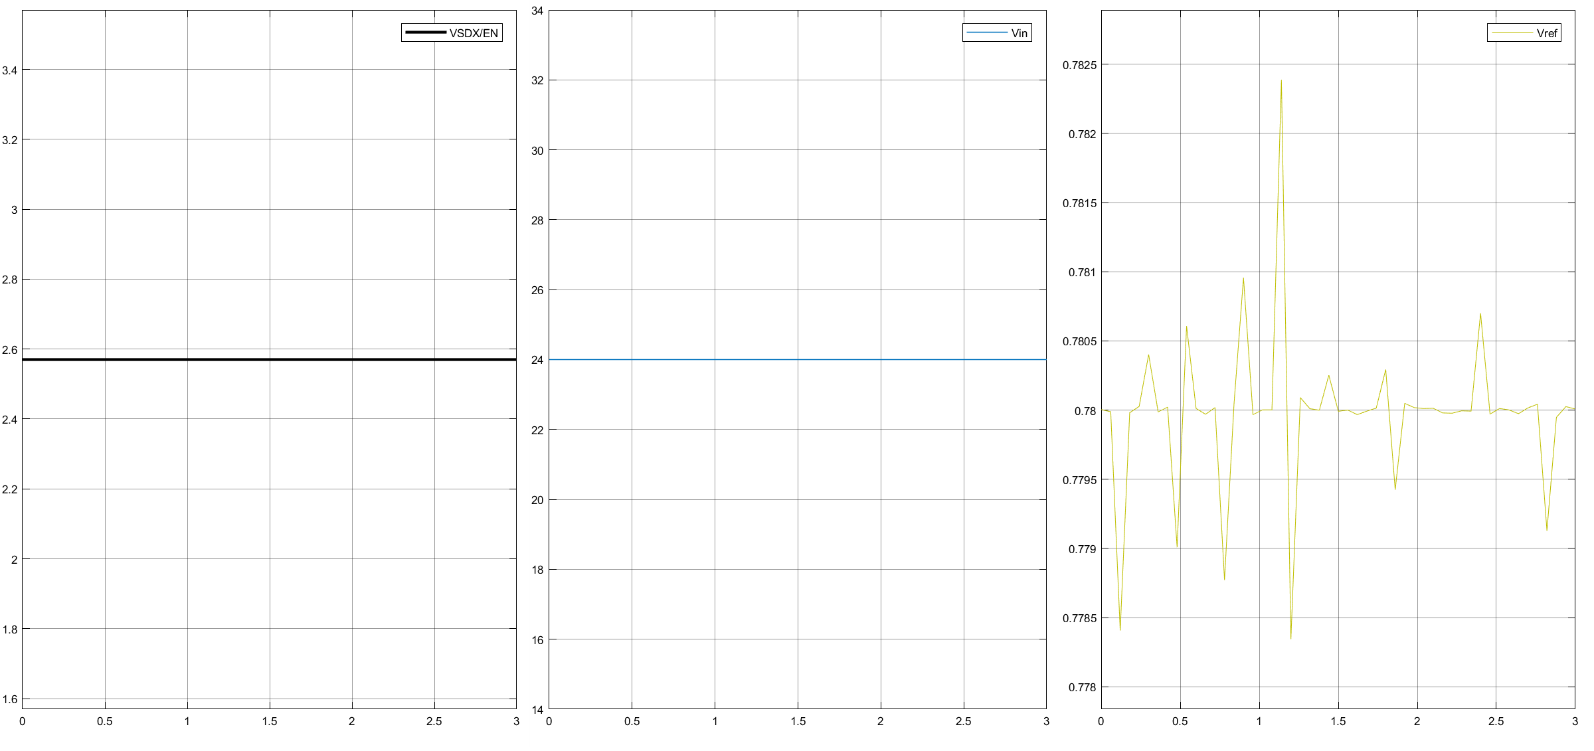
Basic Principles of Power Electronics
Supervisor: Professor Nikolaos Papanikolaou

Slide 12
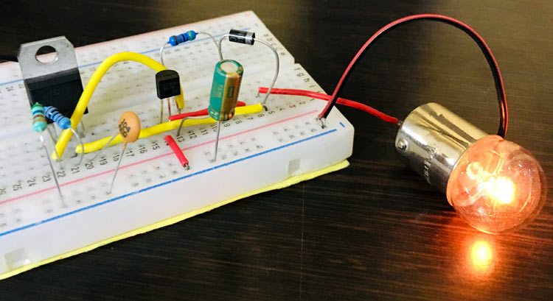
SOFT START
A Soft Start Circuit prevents the sudden current flow in the circuit during the start. It slows down the rate of rising output voltage by minimizing the excess current flow during the start. It is useful to protect the devices or electronic components from the damage caused by instantaneous high input current. Some components which are current limited and having poor load regulation can get damaged because of this high input current.
Basic Principles of Power Electronics
Supervisor: Professor Nikolaos Papanikolaou

Slide 13
Advantages of Soft Start
●Used to reduce the inrush current and increase the durability of device.
● Improve Efficiency
● Soft Start Circuits are cheap and small in size
Negative of Soft Start
● Because of the negative resistance characteristic associated with the inputs of many switchers, insufficient soft-start time will result in high input currents, causing the input voltage source to be pulled down. With a lower input voltage, the switching regulator requires even more input current to correctly start up.
Basic Principles of Power Electronics
Supervisor: Professor Nikolaos Papanikolaou

Slide 14
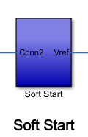
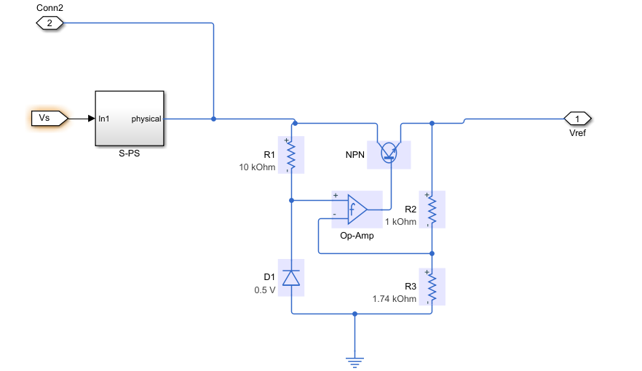
The zener diode D1 sets the non-inverting input of the op-amp to 0.5V, and hence as the op-amp has a large gain, the op-amp inverting input and output are also at 0.5V.
Hence the regulator voltage output is regulated to be 0.5*(1000+1740)/1740=0.7873V. The NPN bipolar transistor is required to provide higher currents than is possible from a typical op-amp.
Basic Principles of Power Electronics
Supervisor: Professor Nikolaos Papanikolaou
Notes:
/

Slide 15
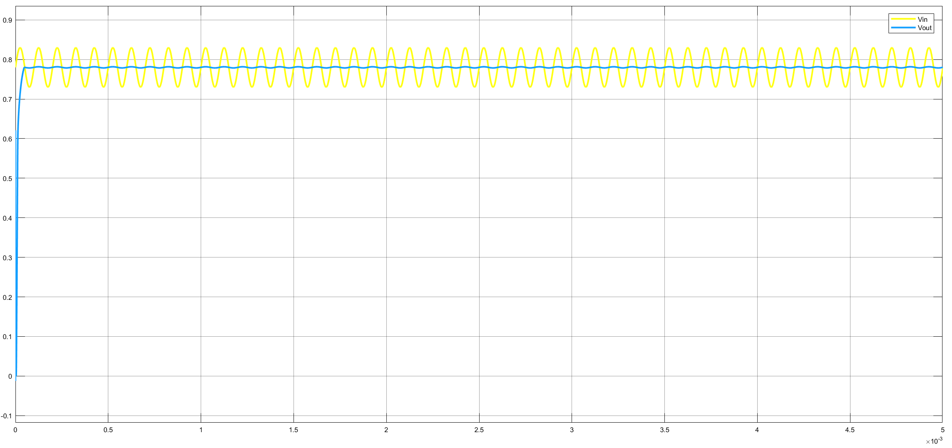
Basic Principles of Power Electronics
Supervisor: Professor Nikolaos Papanikolaou

Slide 16
Basic Principles of Power Electronics
Supervisor: Professor Nikolaos Papanikolaou

